Slide 1
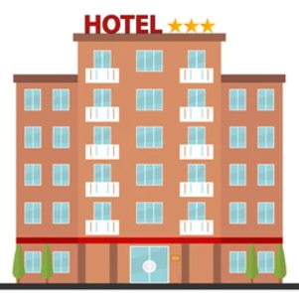


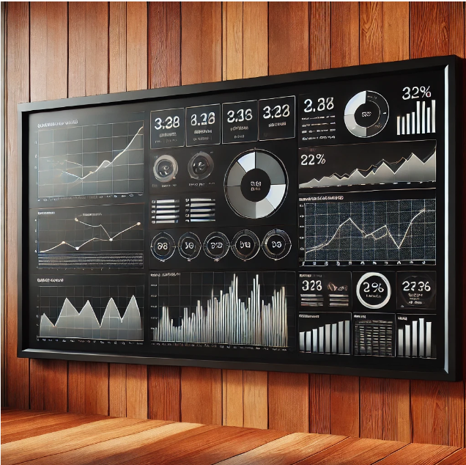
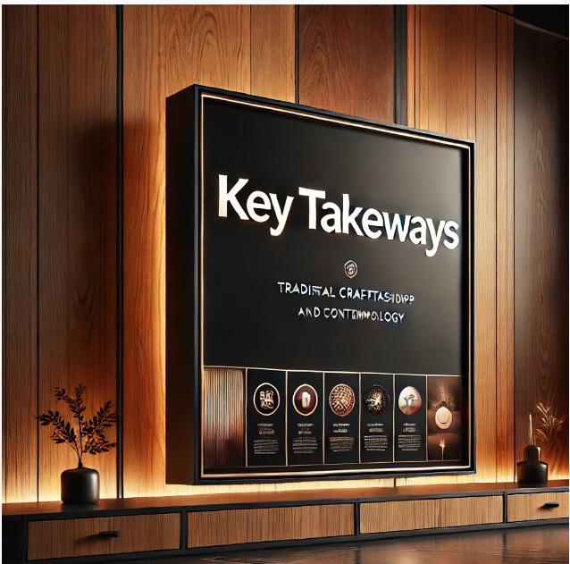
HOSPITALITY ANALYSIS PROJECT
Group- 2
V P Jeevan
Kamal Dudekula
Bhavani Ganga Lingampali
Gayathri Mooram
Babusingh Degavath
Damini Khachane
MPA

Slide 2
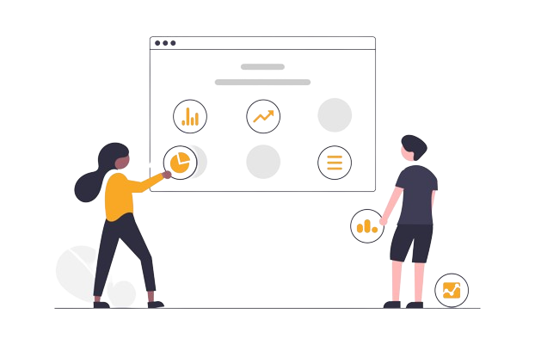





HOSPITALITY ANALYSIS

Slide 3












Summary
The Hospitality Data Analysis Project is a comprehensive study designed to analyze and interpret key metrics in the hotel industry, focusing on bookings, revenue, and customer behavior. By leveraging detailed datasets from a hospitality business, this project seeks to uncover patterns, trends, and actionable insights that can enhance decision-making and operational efficiency for hotel management.
The primary goal of this project is to explore how hotels can optimize their operations and maximize revenue through data-driven insights. The study aims to identify key factors affecting revenue generation, customer booking patterns, and operational performance metrics like occupancy and cancellation rates. With the rise of competitive markets in the hospitality sector, having a clear understanding of customer preferences and operational challenges is essential for maintaining profitability and guest satisfaction.
HOSPITALITY ANALYSIS
Dashboard

Slide 4
KPI’s
HOSPITALITY
ANALYSIS
Total Revenue
Cancellation Rate
Occupancy
Total Booking
Utilize Capacity
Trend Analysis
Weekday & Weekend revenue and bookings
Revenue by state & hotels
Class wise revenue
Checked out cancel no show
Weekly trend key trend ( Revenue, Total booking, occupancy )

Slide 5
Dashboard
We successfully completed a comprehensive Hospitality analysis project, creating integrated dashboards in Excel, Tableau, and Power BI to enhance data visualization and decision-making. Our use of advanced SQL queries improved data management, accuracy, and accessibility. Providing actionable insights that drove strategic decisions.
HOSPITALITY ANALYSIS
Dashboard

Slide 6
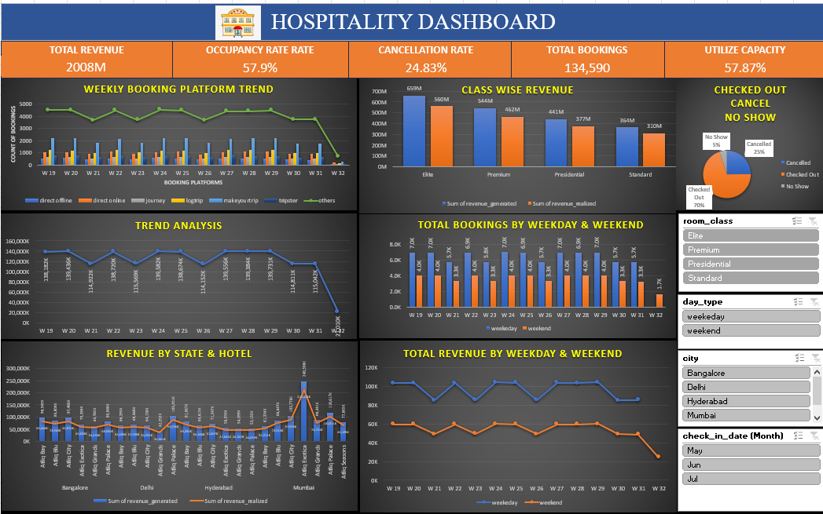
Dashboard
Excel Dashboard

Slide 7
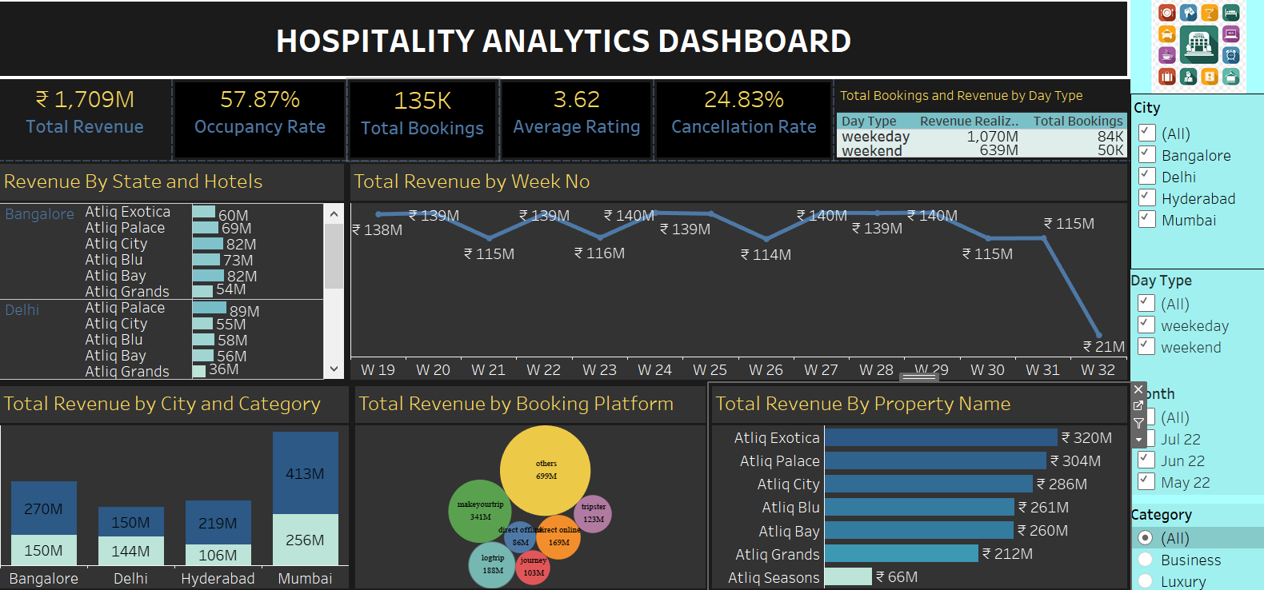
Tableau Dashboard

Slide 8
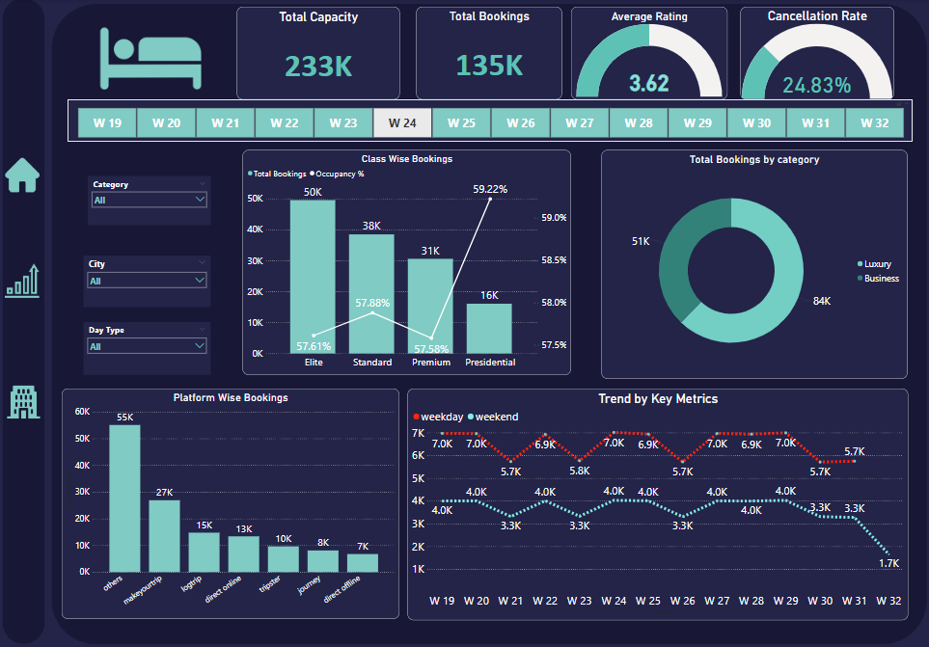
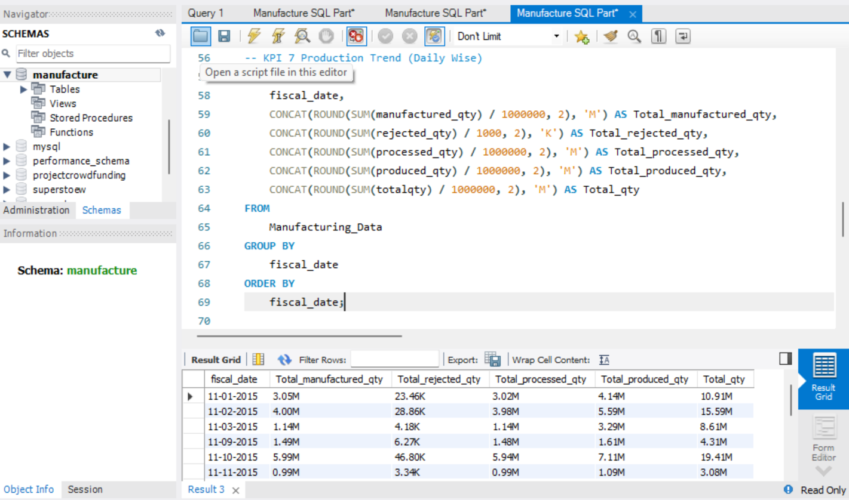
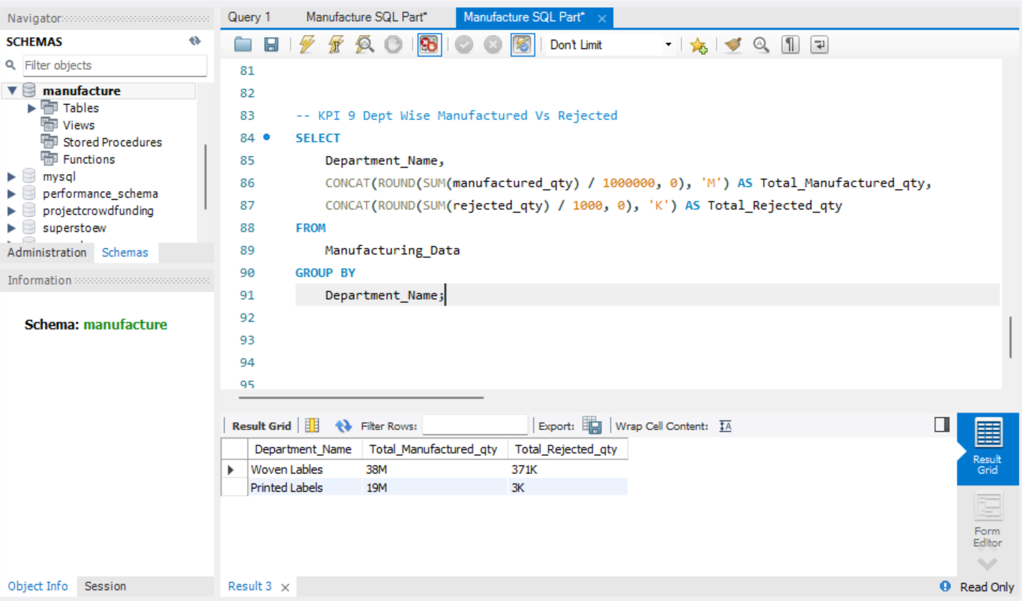
Power BI Dashboard

Slide 9
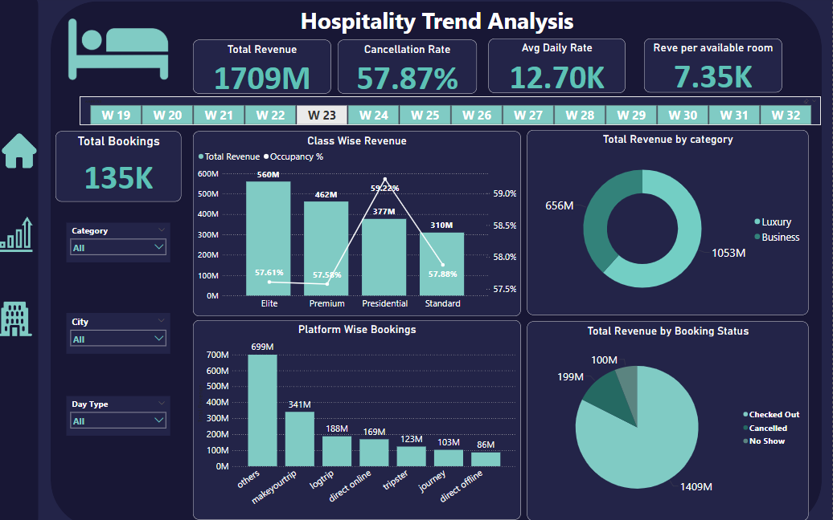
Power BI Dashboard

Slide 10
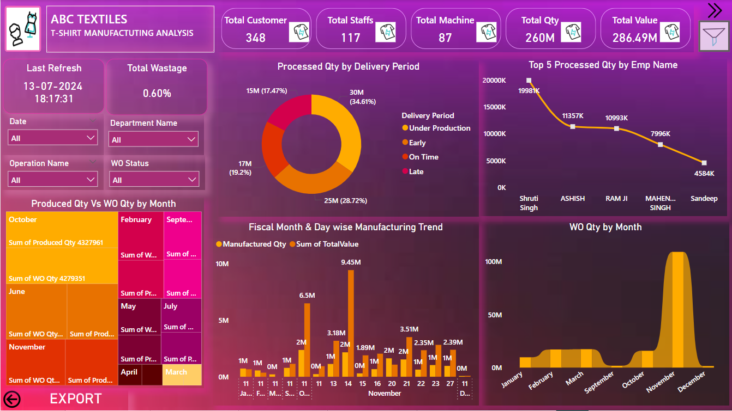
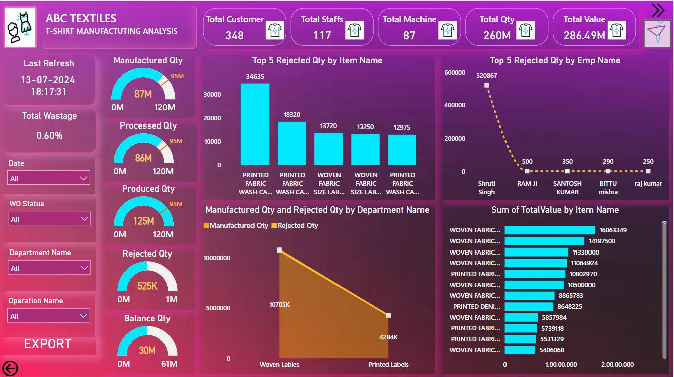
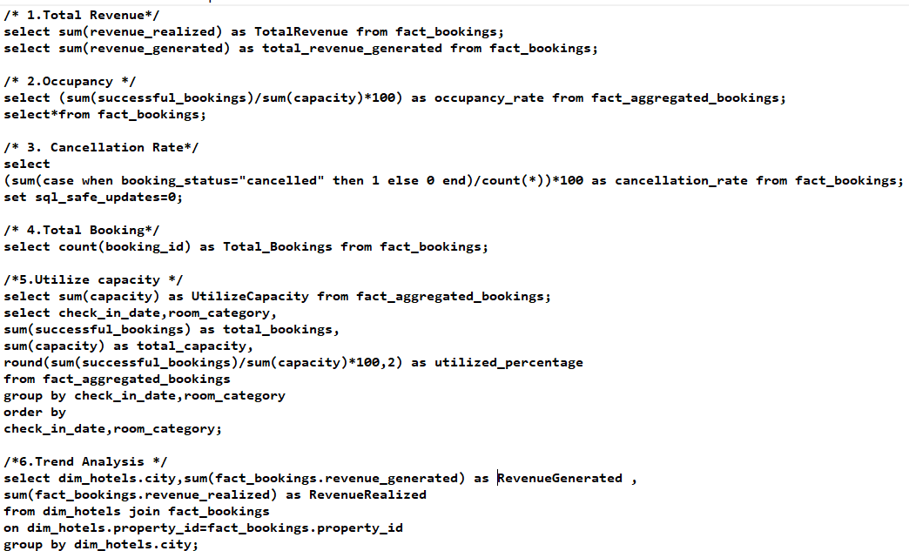








Slide 11
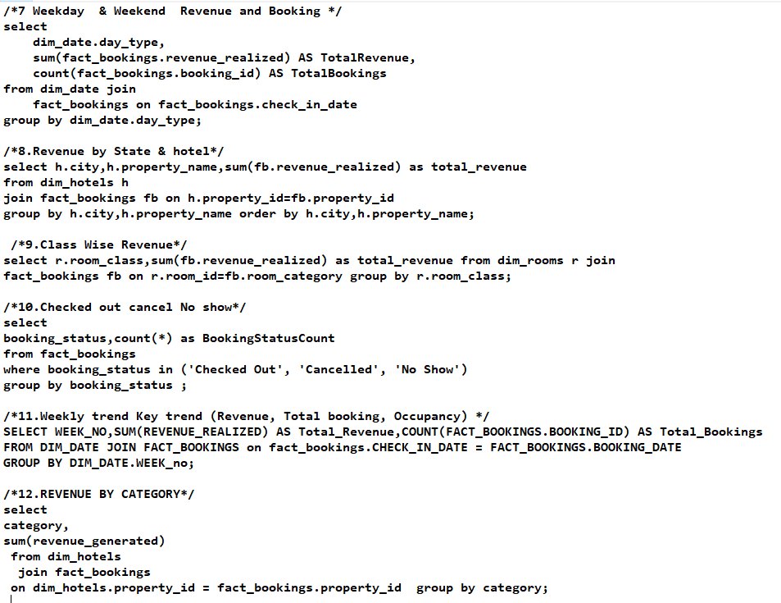

Slide 12
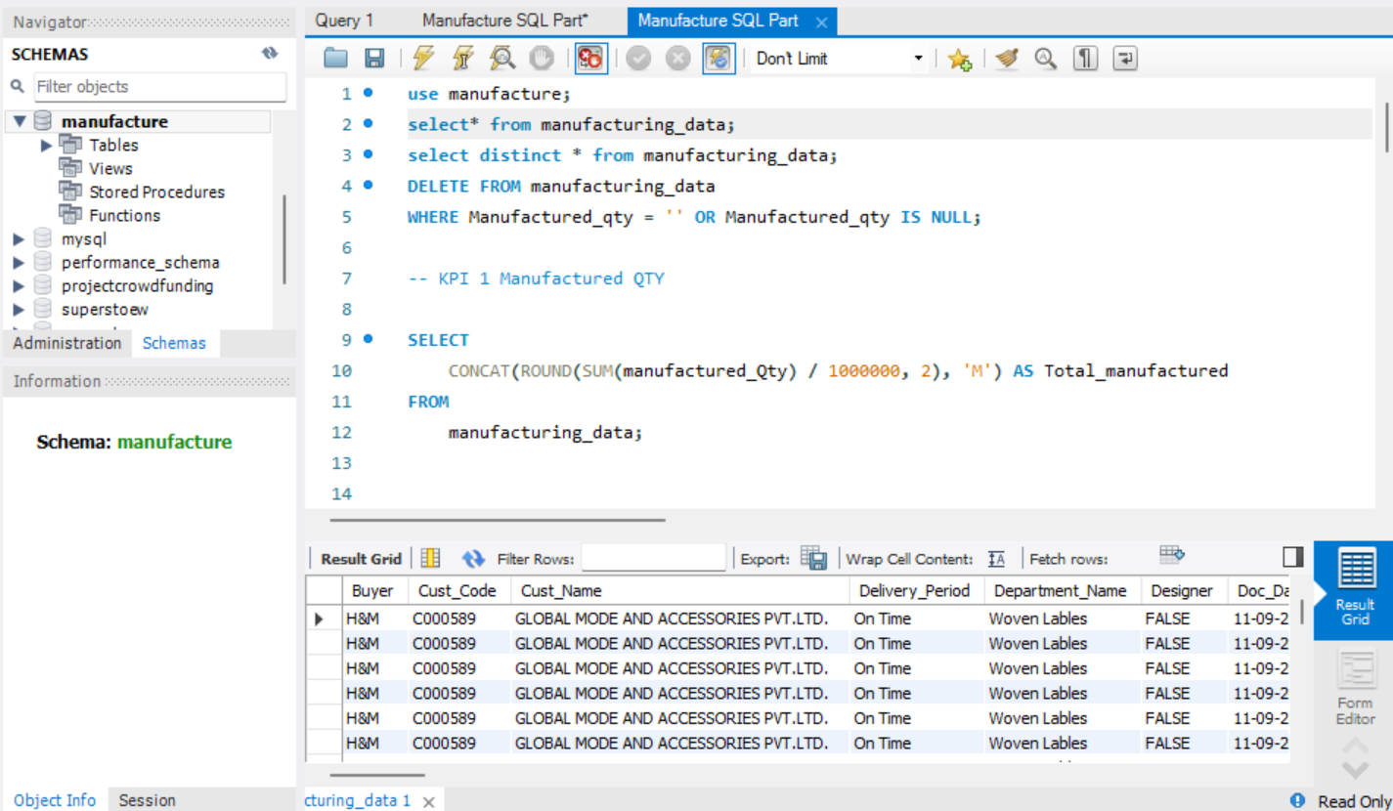

Key Takeaways
1. Revenue Optimization
Introduce dynamic pricing to maximize revenue during low-demand periods.
Promote upselling and cross-selling of higher room categories and services.
Launch targeted promotional campaigns to boost revenue during underperforming weeks and cities.
2. Occupancy Rate Improvement
Use data-driven marketing campaigns to attract guests in low-demand periods.
Partner with corporations for weekday bookings and expand loyalty programs for repeat customers.
3. Cancellation Rate Reduction
Implement flexible booking policies (e.g., partial refunds or credits).
Provide incentives for non-cancelable bookings and prepayments.
HOSPITALITY ANALYSIS
Thank You

Slide 13
Key Takeaways
4. Platform Optimization
Focus on top-performing platforms like MakeYourTrip for partnerships.
Promote direct online bookings through exclusive deals.
5. Property-Specific Strategies
Address challenges at underperforming properties with upgrades or targeted campaigns.
Partner with local attractions to enhance guest experiences and drive bookings.
6. Room Class Performance
Enhance amenities for Standard and Premium classes to boost demand.
Offer personalized discounts and upgrades for loyalty members.
7. Addressing No-Shows
Require partial prepayments to reduce cancellations.
Send automated check-in reminders to guests.
HOSPITALITY ANALYSIS
Thank You

Slide 14
Thank You

